Slide 1
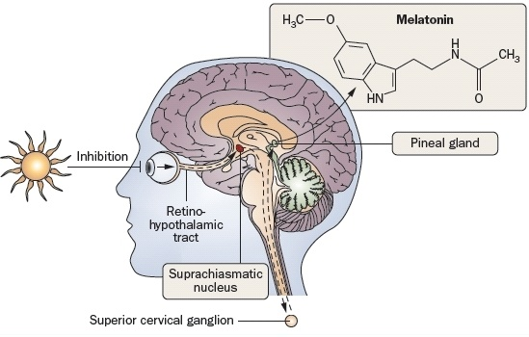
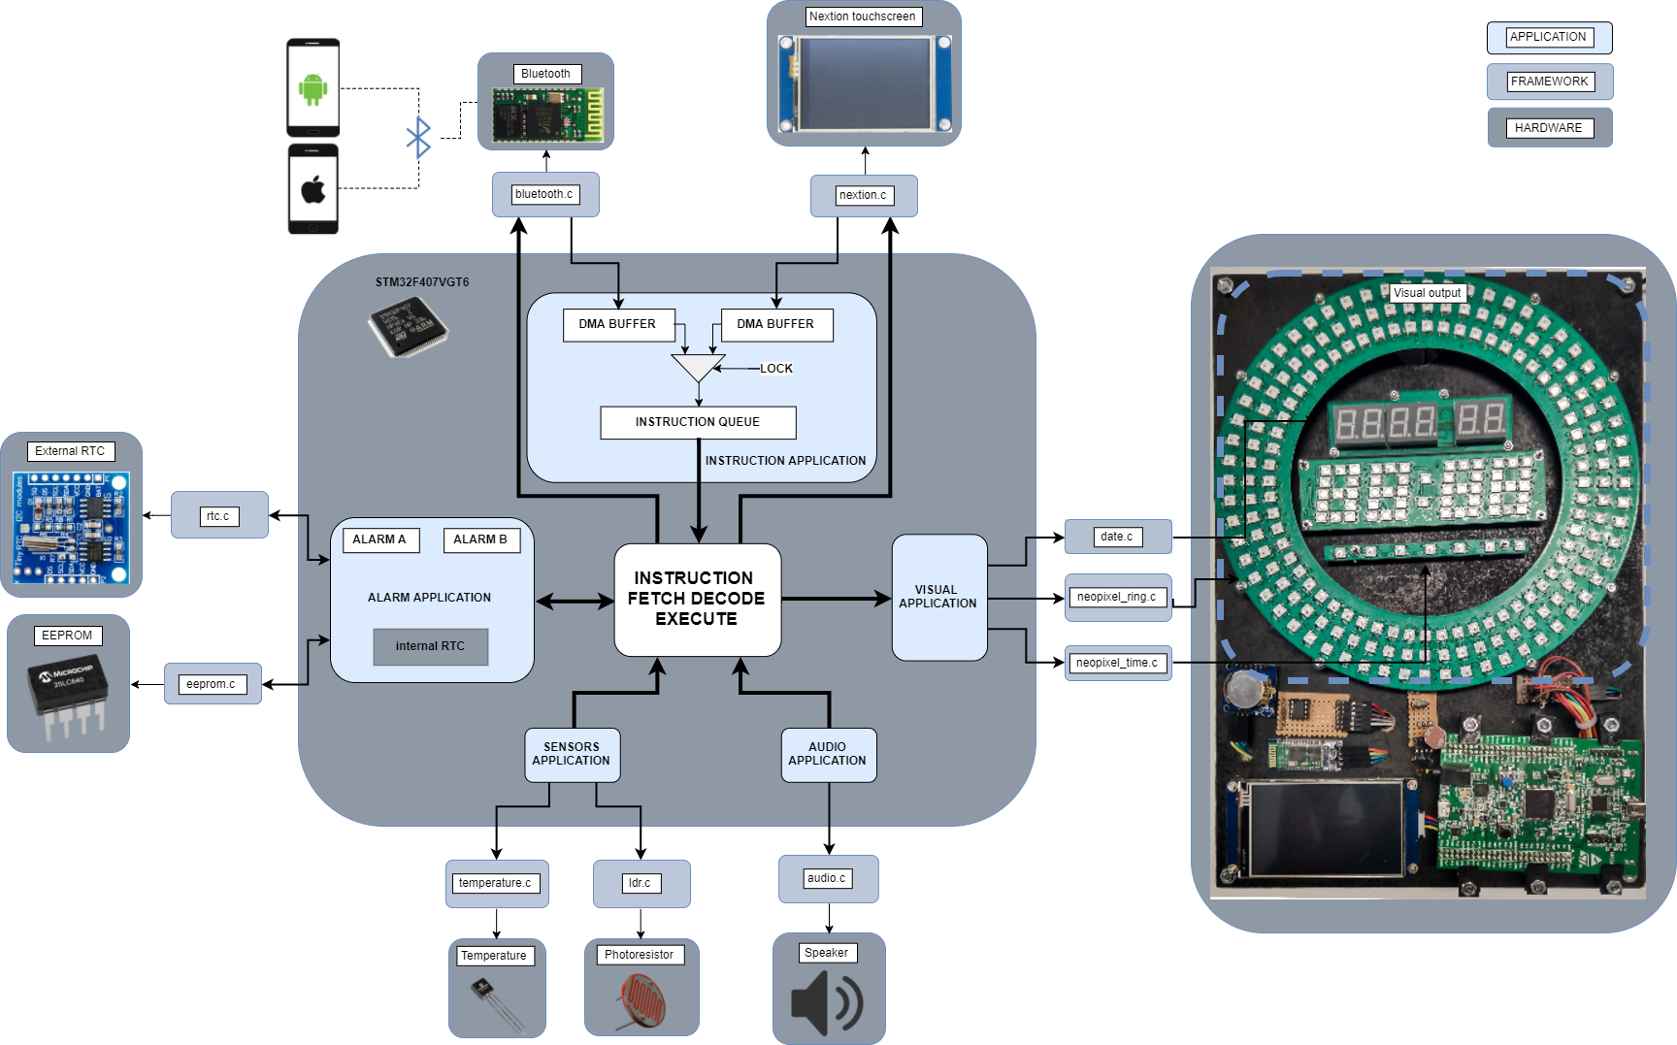
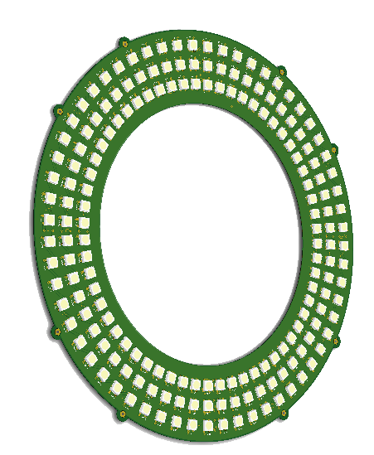
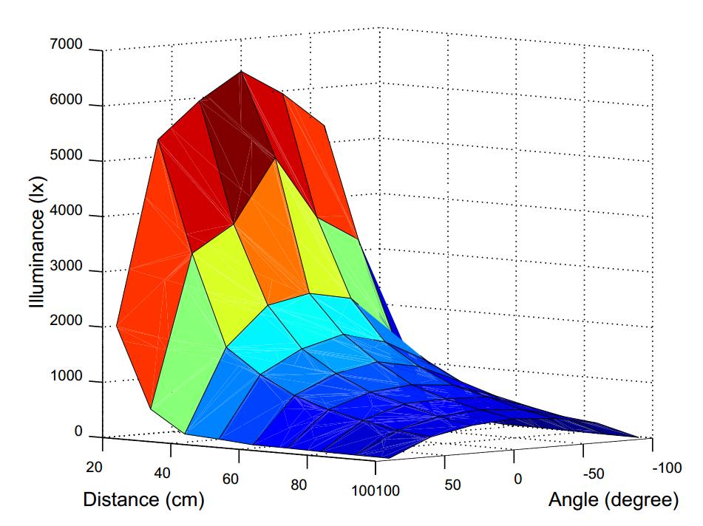
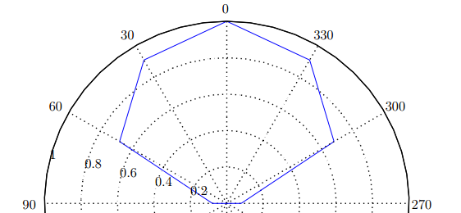
NeoPixel Sunrise Clock (NPSC)
An Intelligent Bedside Clock
BACKGROUND
OBJECTIVES
Studies made on human behavioural patterns have revealed that light can affect the sleep-wake cycle by controlling the production of melatonin
Create a device capable of generating light emission patterns which can produce both soporific and gentle awakening effects on humans, to control the human sleep-wake cycle in a more gentle manner that can have health benefits. The proposed device is planned as a type of alarm clock product, which can assist in the cure of sleep disorders
SYSTEM OVERVIEW
Two inputs
Smartphone application
Onboard touchscreen
System hierarchy
Application (top)
Framework (middle)
Hardware (Bottom)
Visual outputs
Ring for emitting light of 460nm+-10nm @ 30lx
Time & Weekday
Date & Temperature
Storage capacity
64 KB eeprom
Real Time Clock
Alarms
Sensors
Outside temperature
Outside light sensor
RING SPECIFICATIONS
SYSTEM HIERARCHY
180 neopixels
5V @ 7.5A max
37.5W max
21 x 21 cm^2
RGB colours
255x255x255x180 colour combinations
refresh rate >= 5.4ms
Blue light of 465nm wavelength capable of significantly reduce the production of the sleeping hormone emit up to 30lx at an object place 1m meter away and at 90 degree angle from the normal to the Ring’s surface.
MATHEMATICAL MODELS
Illuminance distribution as a function:
of the distance: f(x) =
of the angular position: f(x)=
of Current (A) : f(x)
Temperature (C) vs Current (A) :
f(x)=
Illuminance distribution of the Ring follows Lambert’s Cosine Law. As expected, object positioned on the normal to the Ring’s surface receive most of the illuminance emitted.
WHAT’S NEXT?
“Art is never finished, only abandoned.” Leonardo da Vinci.
This piece of art can be improved in the following ways:
Use the equations describing the behaviour of the Ring to design light patterns providing quantitative descriptions of the illuminance received by the user.
Integrate the NPSC in the IoT device family
UCT LOGO
LOGO, LOGO Name & contact

